Slide 1
Clipper App: Tools and Features

Slide 2
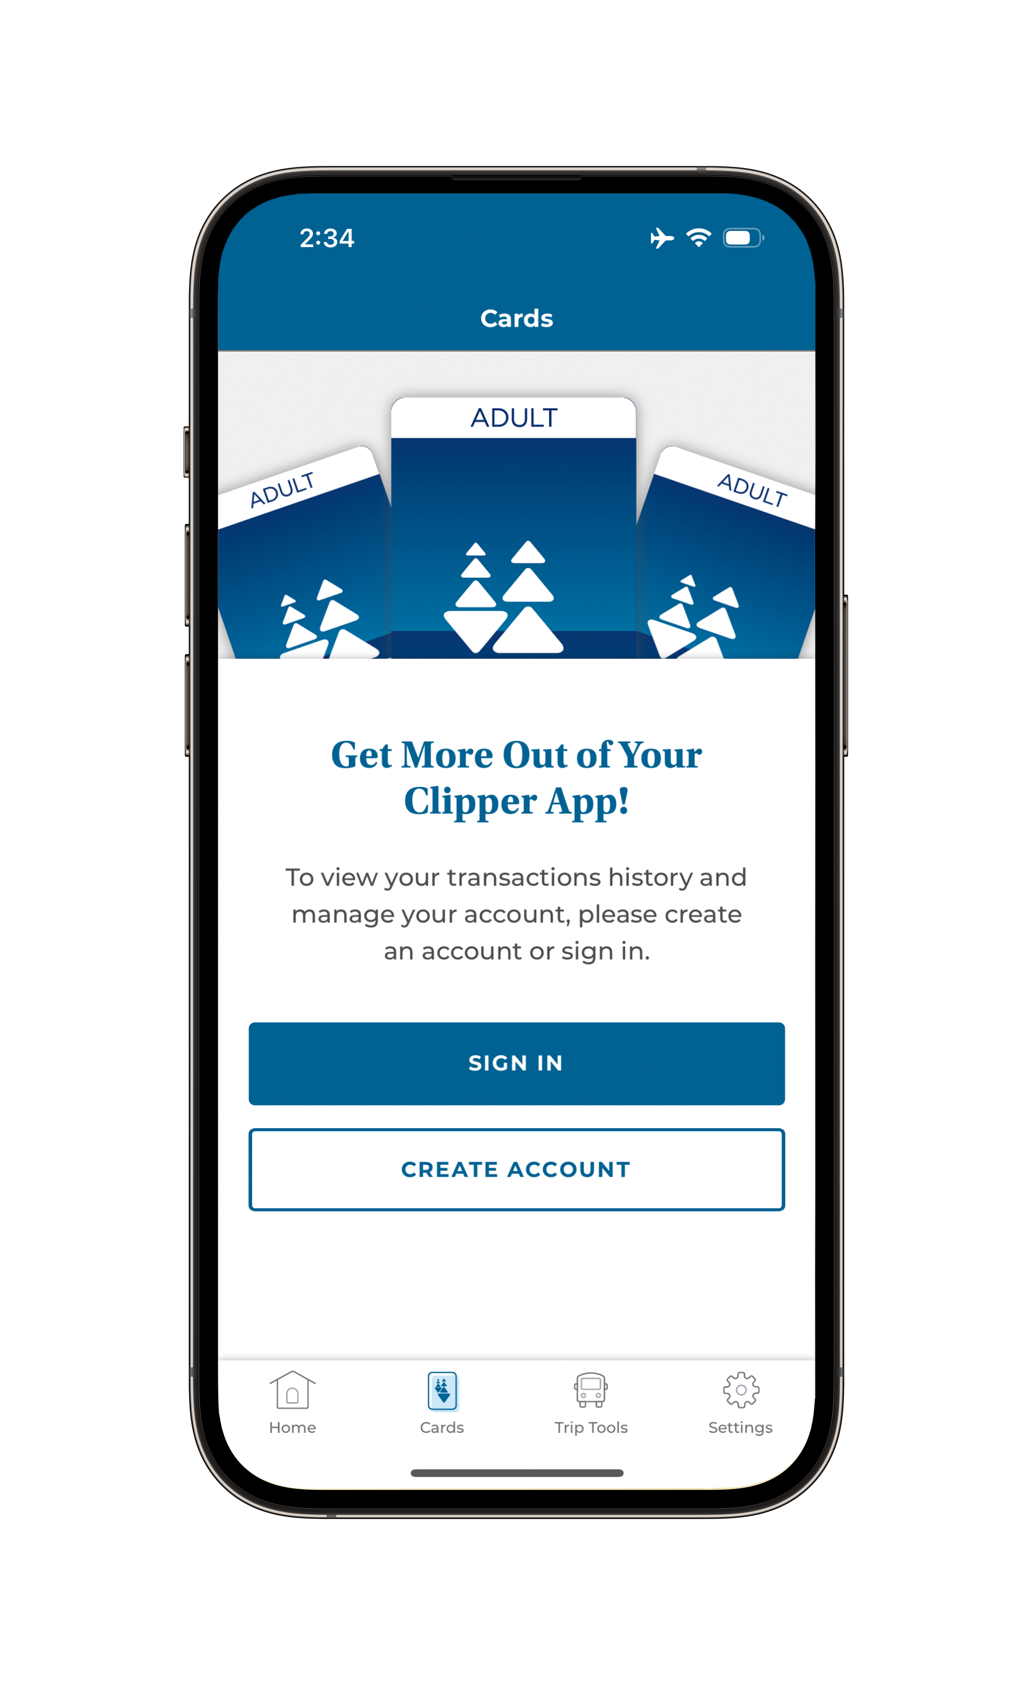
EXISTING IN-APP FEATURES:
Load cash value
Load a transit pass
Manage Autoload
Trip tools

Slide 3
TIP
The Clipper app lets you manage your card, but you will need a Clipper card in your Apple Wallet or Google Wallet to pay for transit.
Note: The Clipper app cannot be used to pay transit fares.

Slide 4
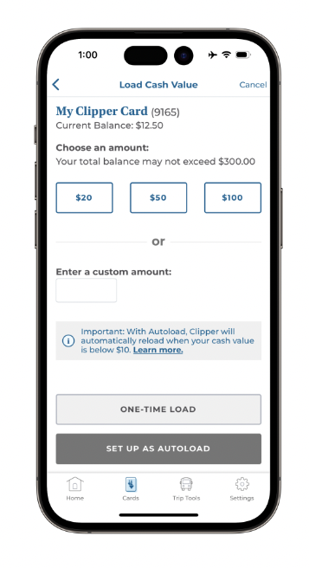
1: LOAD CASH VALUE
Add cash value to your mobile or plastic Clipper card(s) on the Load Cash Value screen

Slide 5
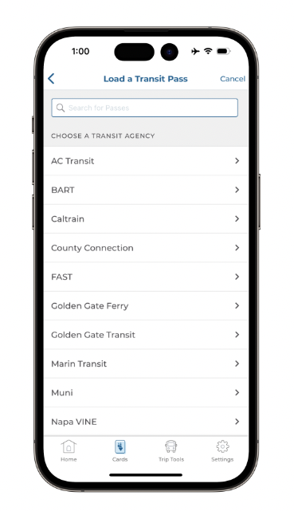
2: LOAD A TRANSIT PASS
Purchase a transit pass and save on rides

Slide 6
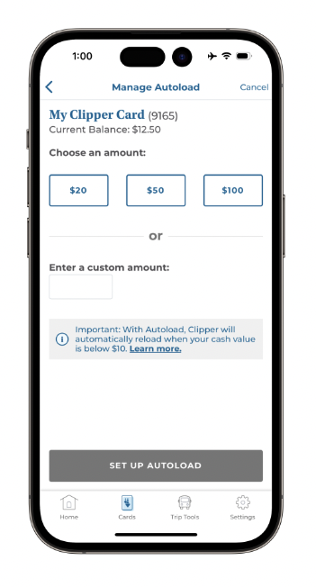
3: MANAGE AUTOLOAD
Use Autoload for passes and cash value

Slide 7
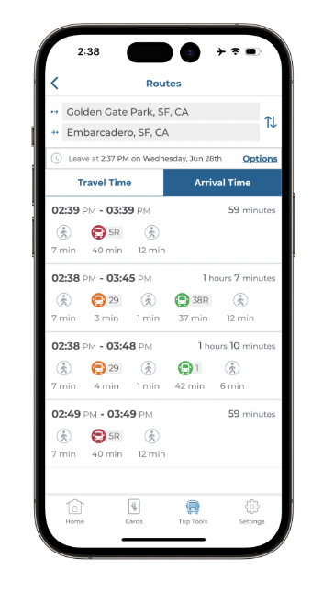
4: TRIP TOOLS
Plan your next trip before you leave — Trip Tools include real-time information

Slide 8
How to Load Cash Value
LOAD CASH VALUE:

Slide 9
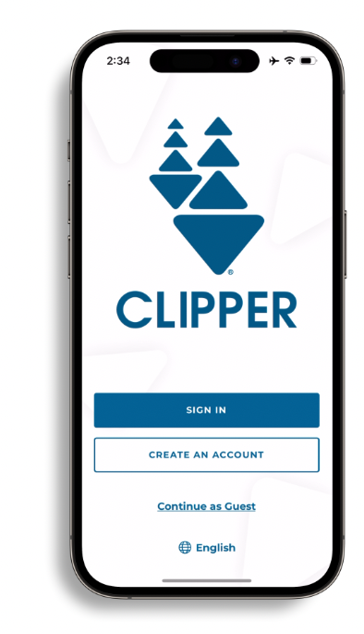
STEP 1
Open the Clipper App and sign in to your account
APP FEATURE: LOAD CASH VALUE

Slide 10
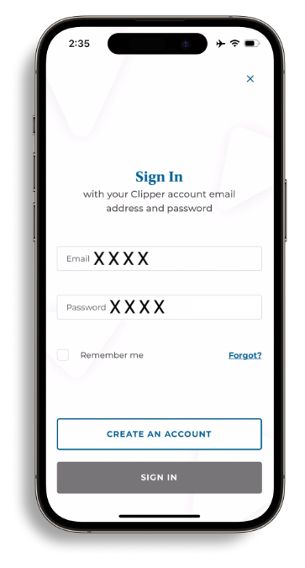
STEP 1
Open the Clipper App and sign in to your account
APP FEATURE: LOAD CASH VALUE

Slide 11
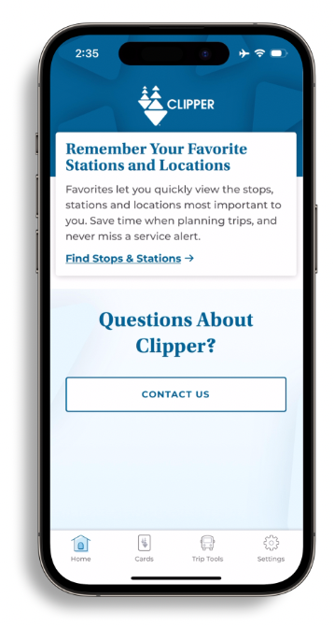
STEP 2
Select the “Cards” option at the bottom of your screen
APP FEATURE: LOAD CASH VALUE

Slide 12
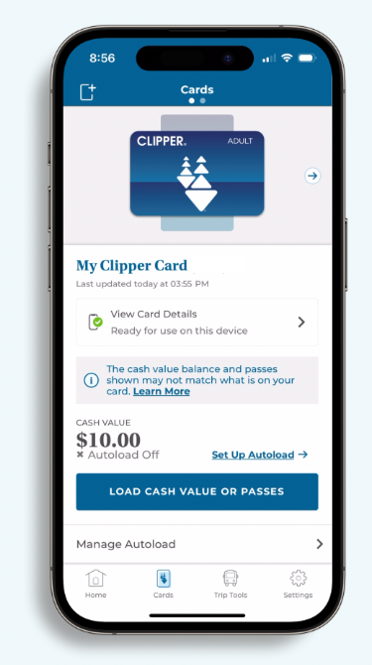
Note on How to Access Multiple Cards
Note: If you have more than one Clipper card in your app, you will have to swipe to select the one you would like to use.﻿
APP FEATURE: LOAD CASH VALUE

Slide 13
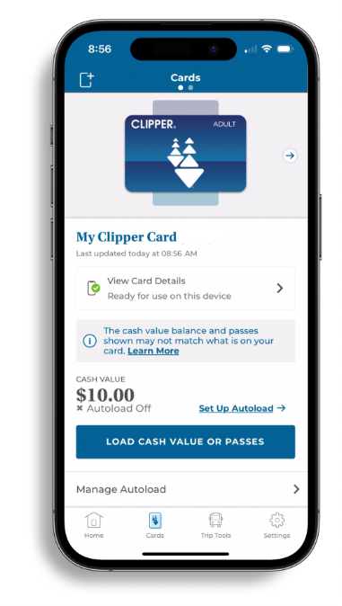
STEP 3
Tap “Load Cash Value or Passes”
APP FEATURE: LOAD CASH VALUE

Slide 14
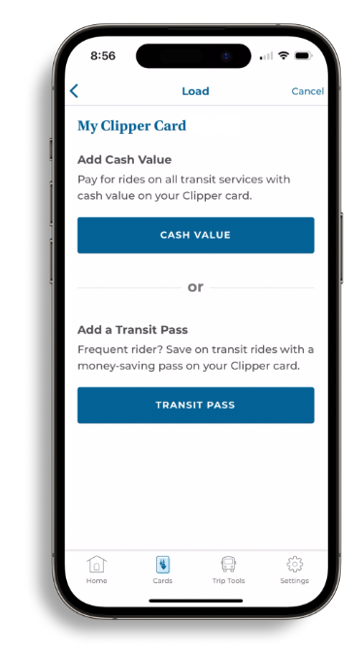
STEP 3
Select “Cash Value”
APP FEATURE: LOAD CASH VALUE

Slide 15
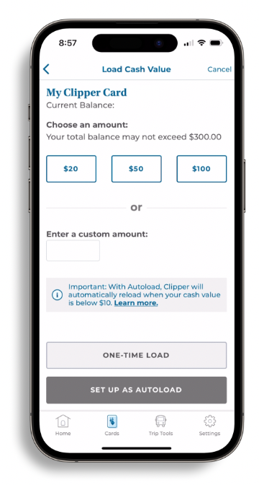
STEP 4
Choose an amount to add
APP FEATURE: LOAD CASH VALUE

Slide 16
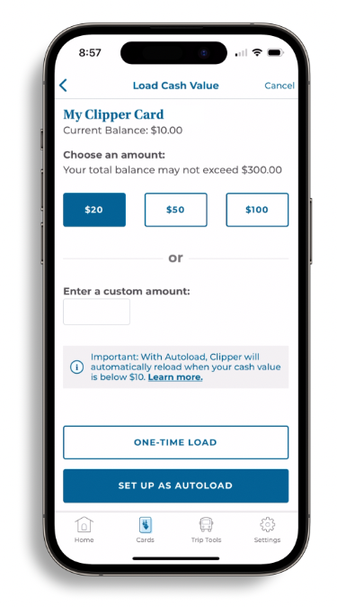
STEP 5
Select “One-Time Load” or “Set Up as Autoload”
APP FEATURE: LOAD CASH VALUE

Slide 17
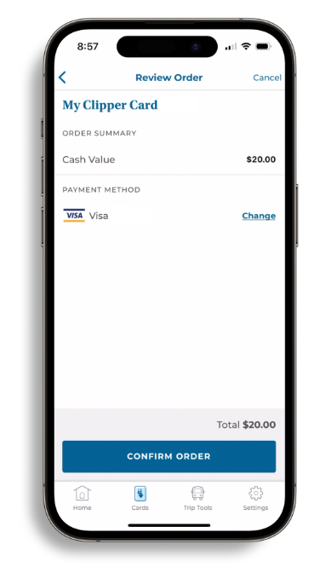
STEP 6
Tap “Confirm Order”
APP FEATURE: LOAD CASH VALUE

Slide 18
LOAD PASSES:
How to Load a Transit Pass

Slide 19
STEP 1
Open the Clipper App and sign in to your account
APP FEATURE: LOAD A TRANSIT PASS

Slide 20
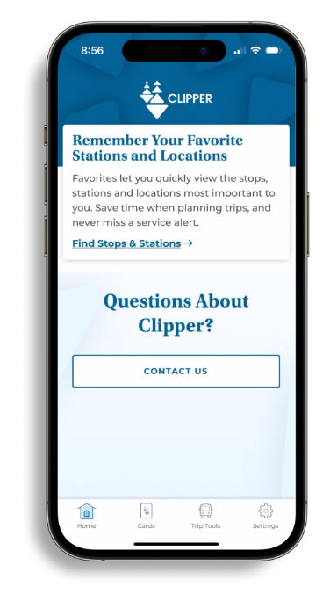
STEP 2
Select the “Cards” option at the bottom of your screen
APP FEATURE: LOAD A TRANSIT PASS

Slide 21
Note on How to Access Multiple Cards
Note: If you have more than one Clipper card in your app, you will have to swipe to select the one you would like to use.﻿
APP FEATURE: LOAD A TRANSIT PASS

Slide 22
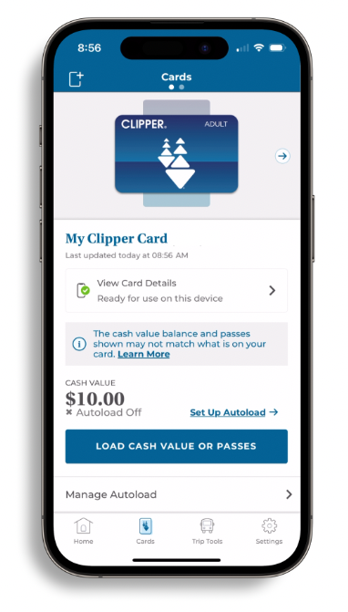
STEP 2
Tap “Load Cash Value or Passes”
APP FEATURE: LOAD A TRANSIT PASS

Slide 23
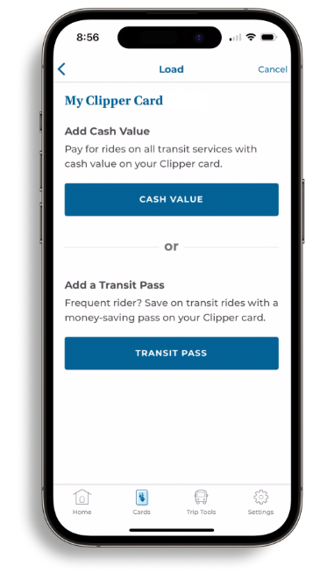
STEP 3
Select “Transit Pass”
APP FEATURE: LOAD A TRANSIT PASS

Slide 24
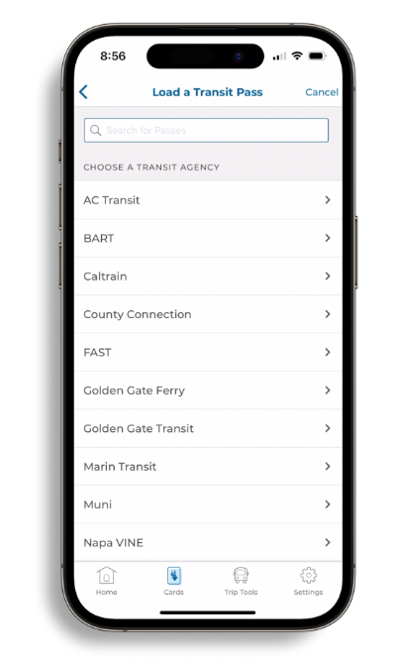
STEP 3
Choose transit agency
APP FEATURE: LOAD A TRANSIT PASS

Slide 25
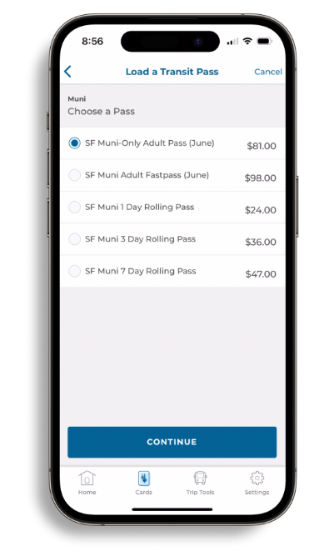
STEP 3
Choose your transit pass and tap “Continue”
APP FEATURE: LOAD A TRANSIT PASS

Slide 26
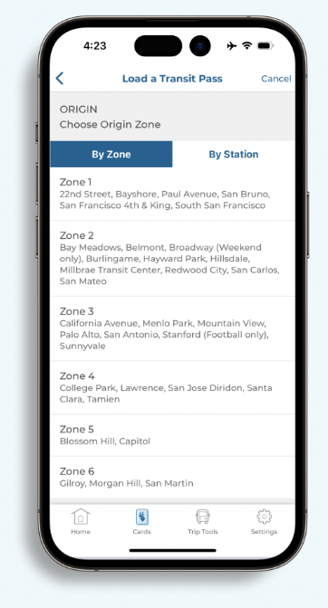
Note on Use of Zone and Station Tabs
Note: Caltrain monthly passes are designated by Zone or by Station. Riders will have to choose an Origin Zone and Destination Zone, or an Origin Station and Destination Station for their monthly pass.
APP FEATURE: LOAD A TRANSIT PASS

Slide 27
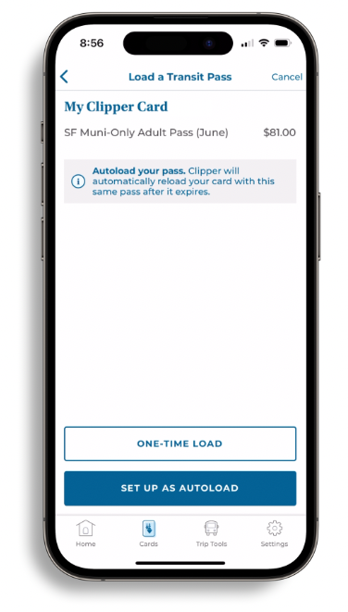
STEP 4
Select “One-Time Load” or “Set Up as Autoload”
APP FEATURE: LOAD A TRANSIT PASS

Slide 28
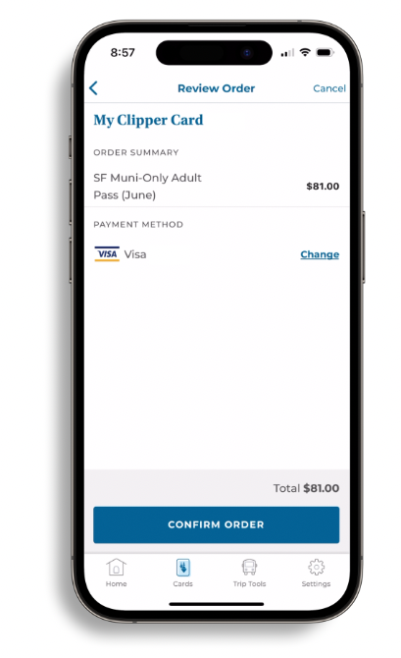
STEP 5
Confirm your order
APP FEATURE: LOAD A TRANSIT PASS

Slide 29
How to Manage Autoload
MANAGE AUTOLOAD:

Slide 30
STEP 1
Open the Clipper app and sign in to your account

Slide 31
STEP 2
Select the “Cards” option at the bottom of your screen
APP FEATURE: MANAGE AUTOLOAD

Slide 32
Note on How to Access Multiple Cards
Note: If you have more than one Clipper card in your app, you will have to swipe to select the one you would like to use.﻿
APP FEATURE: MANAGE AUTOLOAD

Slide 33
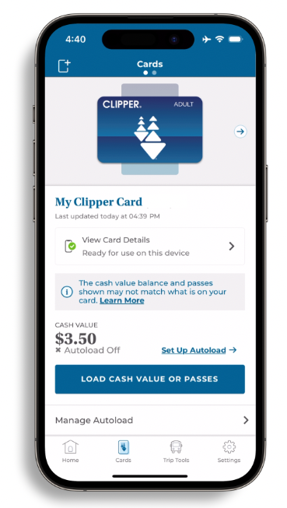
STEP 3
Select “Manage Autoload” to add value
APP FEATURE: MANAGE AUTOLOAD

Slide 34
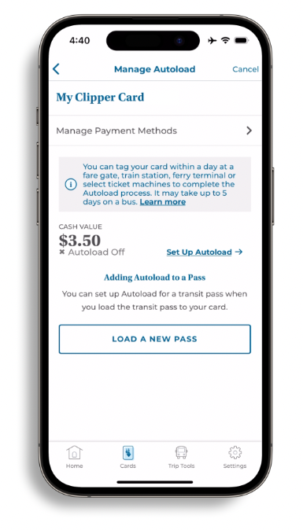
Manage Autoload
You can set up Autoload for cash value or passes
APP FEATURE: MANAGE AUTOLOAD

Slide 35
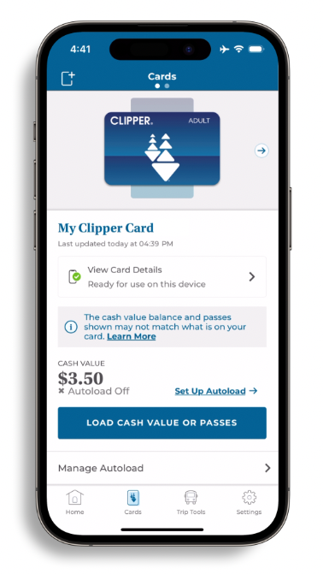
STEP 1
Cash Value Autoload
Tap “Set up Autoload”
APP FEATURE: MANAGE AUTOLOAD

Slide 36
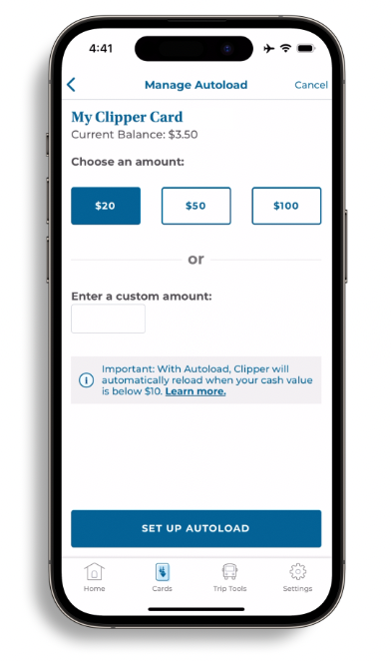
STEP 2
Cash Value Autoload
Choose a recurring cash amount and tap “Set Up Autoload”
APP FEATURE: MANAGE AUTOLOAD

Slide 37
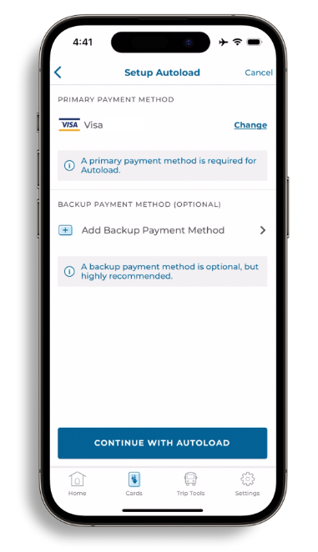
STEP 3
Cash Value Autoload
Tap “Continue with Autoload”
APP FEATURE: MANAGE AUTOLOAD

Slide 38
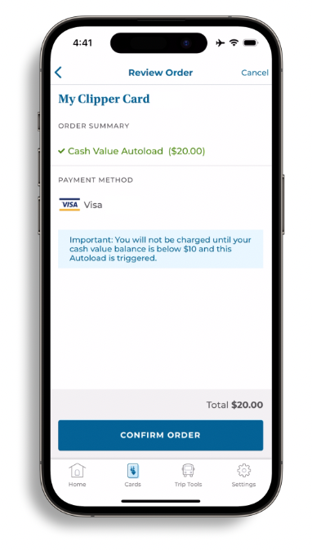
STEP 4
Cash Value Autoload
Tap “Confirm Order”
APP FEATURE: MANAGE AUTOLOAD

Slide 39
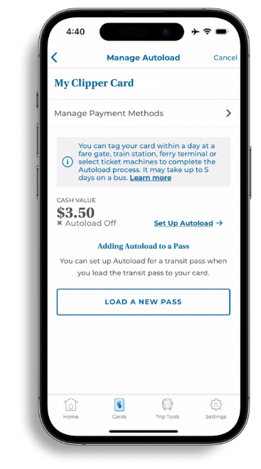
STEP 1
Transit Pass Autoload
Tap “Load a new pass”
APP FEATURE: MANAGE AUTOLOAD

Slide 40
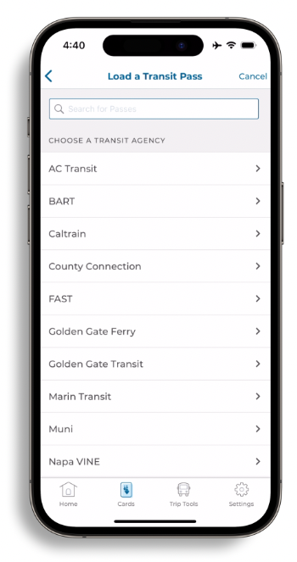
STEP 2
Transit Pass Autoload
Choose a transit agency
APP FEATURE: MANAGE AUTOLOAD

Slide 41
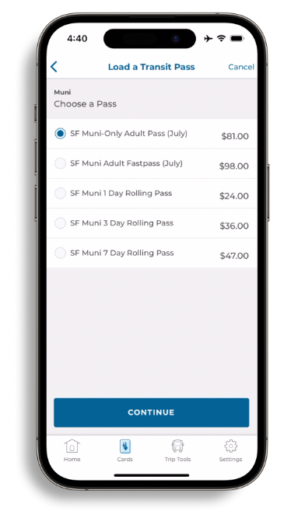
STEP 2
Transit Pass Autoload
Choose a pass and tap “Continue”
APP FEATURE: MANAGE AUTOLOAD

Slide 42
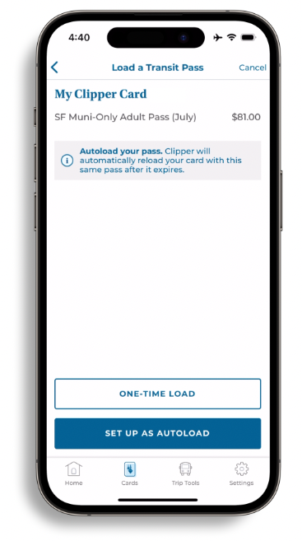
STEP 3
Transit Pass Autoload
Select “Set up as Autoload”
APP FEATURE: MANAGE AUTOLOAD

Slide 43
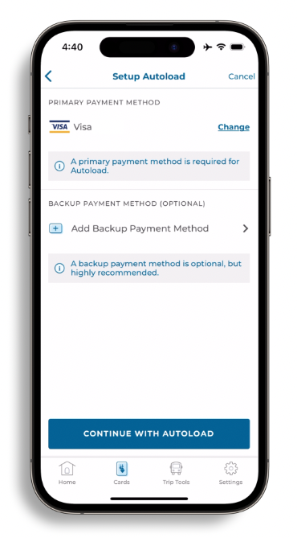
STEP 3
Transit Pass Autoload
Tap “Continue with Autoload”
APP FEATURE: MANAGE AUTOLOAD

Slide 44
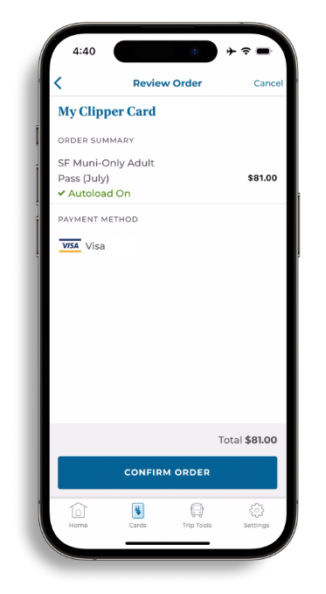
STEP 4
Transit Pass Autoload
Tap “Confirm Order”
APP FEATURE: MANAGE AUTOLOAD

Slide 45
TRIP TOOLS:
How to Use Trip Tools

Slide 46
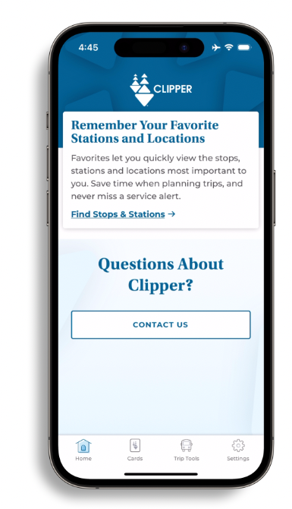
STEP 1
Select the “Trip Tools” option at the bottom of your screen
APP FEATURE: TRIP TOOLS

Slide 47
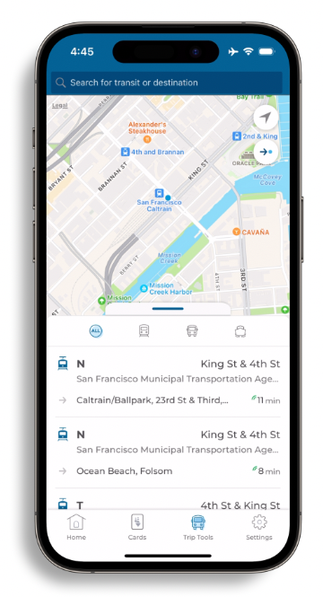
STEP 2
Enter transit or destination in the search bar at the top of the screen
APP FEATURE: TRIP TOOLS

Slide 48
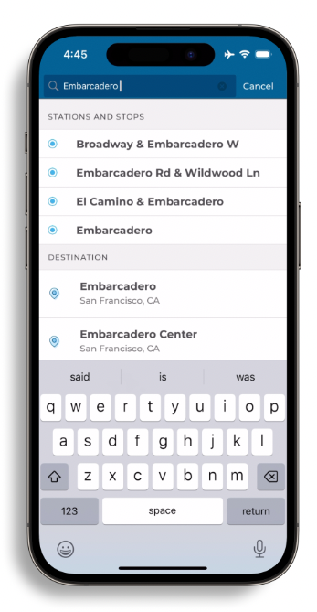
STEP 2
Select your trip destination
APP FEATURE: TRIP TOOLS

Slide 49
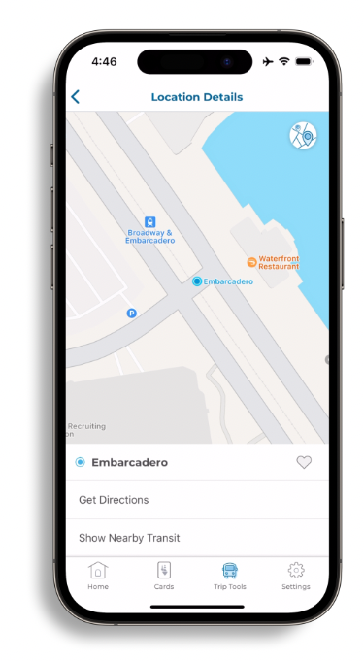
STEP 3
Select “Get Directions”
APP FEATURE: TRIP TOOLS

Slide 50
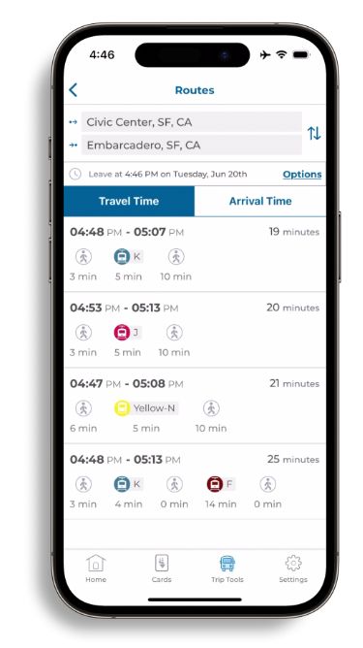
Customizable Features
The Clipper app provides a variety of ways to get to your destination with customizable features
APP FEATURE: TRIP TOOLS

Slide 51
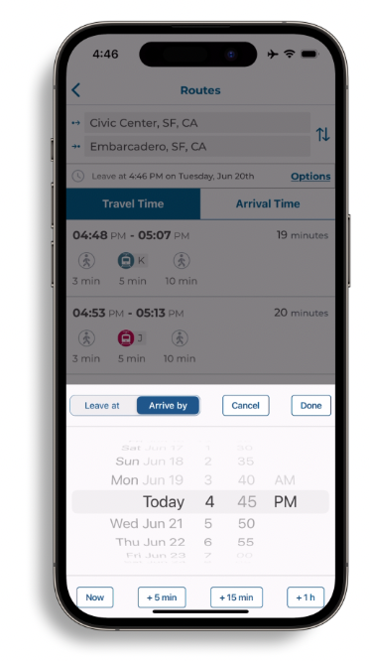
Customizations: Time
Customize your desired departure or arrival time
APP FEATURE: TRIP TOOLS

Slide 52
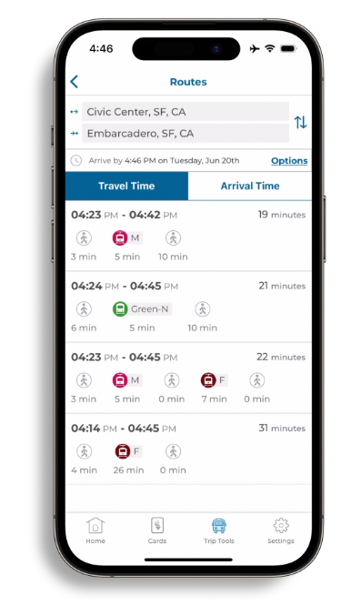
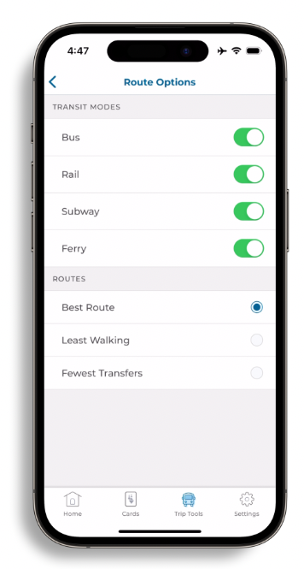
Customizations: Options
Tap “Options” to adjust your preferred transit modes and route
APP FEATURE: TRIP TOOLS

Slide 53
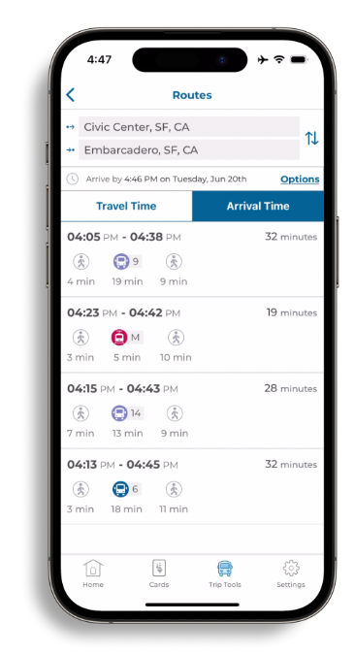
Options for Viewing Routes
View routes by Travel Time or Arrival Time
APP FEATURE: TRIP TOOLS

Slide 54
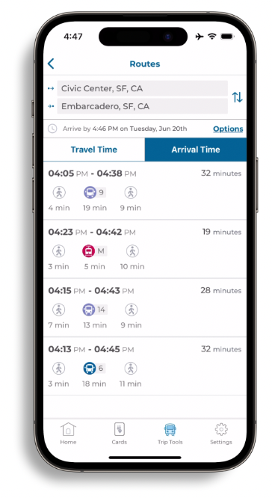
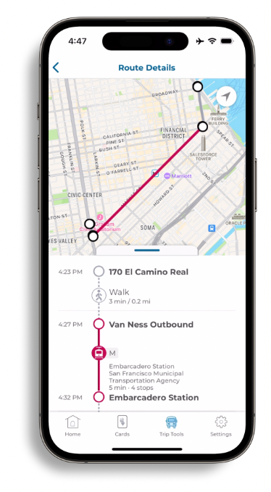
STEP 4
Once your preferences are set, select a route for details
APP FEATURE: TRIP TOOLS

Slide 55
Accessing More Information on the Website
Go to www.clippercard.com/ClipperWeb/clipper-app for more information"

